Slide 1

CLASSIFICATION TRESS, BAGGING, BOOSTING AND RANDOM FOREST
NUTHAN MANIDEEP

Slide 2

ABSTRACT
The World Happiness Report 2015 dataset contains data on the happiness levels of people in 159 countries around the world. It includes information on a variety of factors that are thought to contribute to happiness, such as economic factors (GDP per capita), social factors (family, health, and freedom), and trust in government. The data also includes a happiness score and a happiness rank for each country. The happiness score and happiness rank are based on a poll in which people were asked to rate their overall happiness on a scale of 0 to 10. The economy, family, health, freedom, trust, and generosity columns contain various measures of those factors. Overall, the World Happiness Report 2015 dataset provides valuable insights into the factors that contribute to happiness and well-being at the national level, and can be used by researchers, policymakers, and others to better understand and promote happiness around the world.

Slide 3
DATA
.
The dataset can be found on Kaggle and it contains data on happiness levels of people in 159 countries around the world. The data is collected in the year 2015 and it includes information on a variety of factors that are thought to contribute to happiness, such as:
Column Name | Description
Country or Region | Name of the country
Happiness Score | A composite score of overall well-being
Economy (GDP per Capita) | Measure of the economic production of a country
Family | Measure of social support
Health (Life Expectancy) | Measure of the health of citizens
Freedom | Measure of freedom to make life choices
Generosity | Measure of generosity of citizens
Trust (Government Corruption) | Measure of trust in government

Slide 4
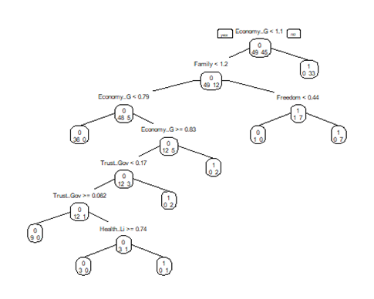
CLASSIFICATION TREE
A classification tree is a graphical representation of a series of decisions or rules that are made based on the values of the predictor variables.
The tree was built with all variables.
Variables actually used in tree construction are “Economy..GDP.per.Capita.”, “Family”, “Freedom”, “Health..Life.Expectancy.”, “Trust..Government.Corruption”.

Slide 5
CONFUSION MATRIX OF CLASSIFICATION TREE MODEL
The confusion matrix of classification tree model for training data is given below:
 | Predicted Negative (0) | Predicted Positive (1)
Actual Negative (0) | 49 | 0
Actual Positive (1) | 0 | 45
The accuracy of the model is 1. The sensitivity of the model is 1. The specificity of the model is 1.
The confusion matrix of classification tree for validation data is given below:
 | Predicted Negative (0) | Predicted Positive (1)
Actual Negative (0) | 29 | 9
Actual Positive (1) | 6 | 20
The accuracy of the model is 0.765625. The sensitivity of the model is 0.8286. The specificity of the model is 0.6897.

Slide 6
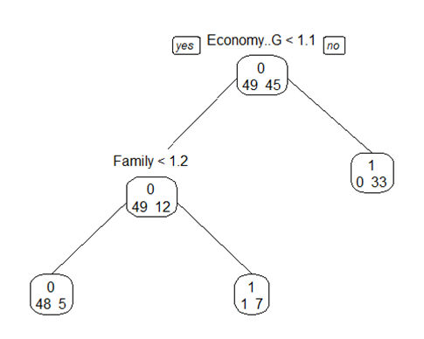
PRUNING TREE
Pruning is a technique used to prevent overfitting in decision trees. Pruning can improve the performance of decision trees by reducing overfitting and increasing the generalization ability of the model.

Slide 7
CONFUSION MATRIX OF PRUNING TREE MODEL
The confusion matrix of pruning tree model for training data is given below:
 | Predicted Negative (0) | Predicted Positive (1)
Actual Negative (0) | 48 | 5
Actual Positive (1) | 1 | 40
The accuracy of the model is 0.9361702. The sensitivity of the model is 0.9796. The specificity of the model is 0.8889.
The confusion matrix of pruning tree for validation data is given below:
 | Predicted Negative (0) | Predicted Positive (1)
Actual Negative (0) | 29 | 9
Actual Positive (1) | 6 | 20
The accuracy of the model is 0.78125. The sensitivity of the model is 0.8571. The specificity of the model is 0.6897.

Slide 8
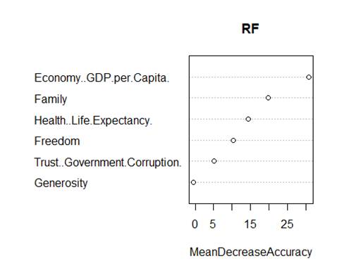
RANDOM FOREST
The basic idea of random forest is to train multiple decision trees on different random subsets of the training data, and then average their predictions to obtain the final prediction. This reduces the risk of overfitting and increases the generalization performance of the model.
The importance of each variable is calculated by measuring the reduction in the impurity of the nodes of the trees in the forest when that variable is used for splitting. The impurity of a node is a measure of how well the node separates the classes of the response variable. The greater the reduction in impurity, the more important the variable.
The plot can be used to identify the most important predictors in the model, which can be useful for understanding the relationships between the predictor variables and the response variable.
The most important variables in the plot are “GDP”, “Family”, “Life Expectancy”, “Freedom”.

Slide 9
CONFUSION MATRIX OF RANDOM FOREST MODEL
The confusion matrix of random forest model for training data is given below:
 | Predicted Negative (0) | Predicted Positive (1)
Actual Negative (0) | 49 | 3
Actual Positive (1) | 0 | 42
The accuracy of the model is 0.9787234. The sensitivity of the model is 1. The specificity of the model is 0.9333.
The confusion matrix of random forest model for validation data is given below:
 | Predicted Negative (0) | Predicted Positive (1)
Actual Negative (0) | 29 | 9
Actual Positive (1) | 6 | 20
The accuracy of the model is 0.78125. The sensitivity of the model is 0.8571. The specificity of the model is 0.6897.

Slide 10
BAGGING
Bagging, short for bootstrap aggregating, is ensemble learning method that combines multiple models to improve the accuracy and stability of the predictions. The basic idea is to generate multiple bootstrap samples of the training data, and then train a separate model on each sample.

Slide 11
CONFUSION MATRIX OF BAGGING MODEL
The confusion matrix of bagging model for training data is given below:
 | Predicted Negative (0) | Predicted Positive (1)
Actual Negative (0) | 47 | 5
Actual Positive (1) | 2 | 40
The accuracy of the model is 0.9255319. The sensitivity of the model is 0.9592. The specificity of the model is 0.8889.
The confusion matrix of bagging model for validation data is given below:
 | Predicted Negative (0) | Predicted Positive (1)
Actual Negative (0) | 28 | 9
Actual Positive (1) | 7 | 20
The accuracy of the model is 0.765625. The sensitivity of the model is 0.8. The specificity of the model is 0.6897.

Slide 12
BOOSTING
Boosting is ensemble learning method that combines multiple models to improve the accuracy of the predictions. The basic idea is to train multiple weak models sequentially, and each model is trained on the residuals of the previous model.

Slide 13
CONFUSION MATRIX OF BOOSTING MODEL
The confusion matrix of boosting model for training data is given below:
 | Predicted Negative (0) | Predicted Positive (1)
Actual Negative (0) | 46 | 4
Actual Positive (1) | 3 | 41
The accuracy of the model is 0.9255319. The sensitivity of the model is 0.9388. The specificity of the model is 0.9111.
The confusion matrix of boosting model for validation data is given below:
 | Predicted Negative (0) | Predicted Positive (1)
Actual Negative (0) | 27 | 9
Actual Positive (1) | 8 | 20
The accuracy of the model is 0.734375. The sensitivity of the model is 0.7714. The specificity of the model is 0.6897.

Slide 14
BEST MODEL
The analysis reveals that among all constructed models, the random forest model stands out as the best performer. When applied to the validation data, this model demonstrates the highest accuracy, with a value of 0.765625

Slide 15
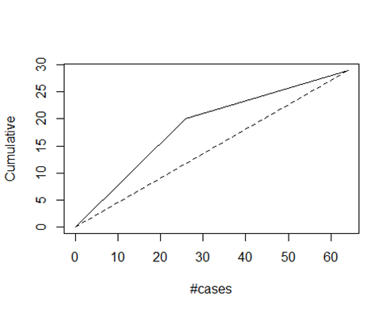
GAINS PLOT FOR BEST MODEL
The gains plot demonstrates a direct proportionality between the area enclosed by the dotted line (representing random sample selection) and the model curve. A larger area signifies superior model performance. This plot serves as a visual tool to effectively represent the predictive power of the model and enables straightforward comparison across multiple models.

Slide 16
CONCLUSION
After thorough analysis of all the models, it can be concluded that the random forest model performs the best. The model achieves an accuracy of 0.765625, sensitivity 0.8286, specificity of 0.6897 based on the evaluation results. The most important variables in the plot are “GDP”, “Family”, “Life Expectancy”, “Freedom”.

Slide 17

THANK YOU!

